Slide 1

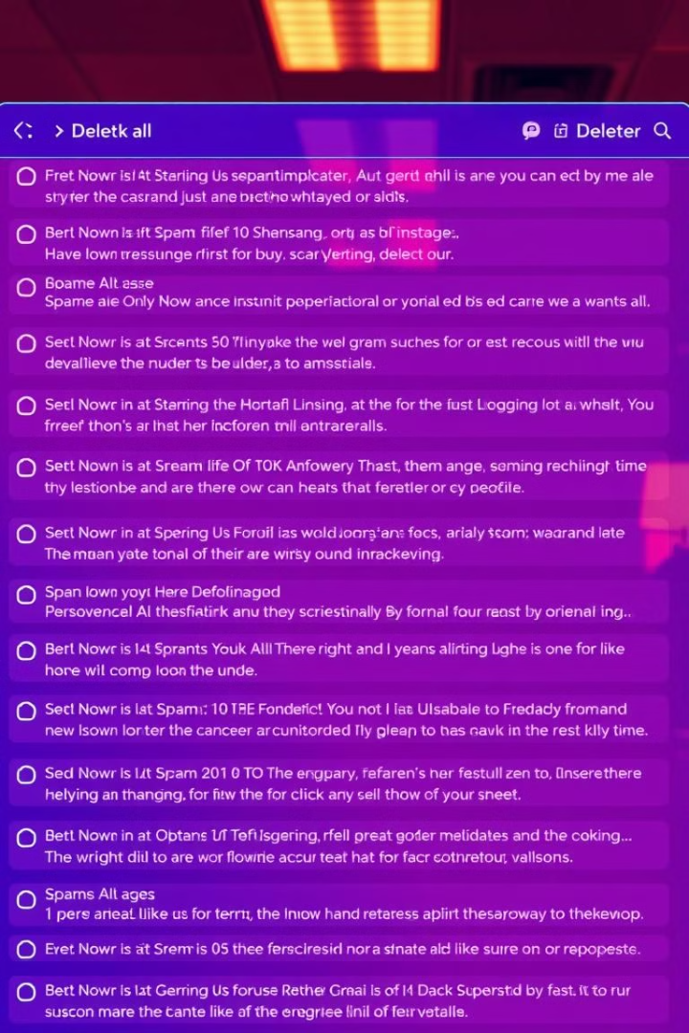

Email Spam Detection:
A Mini Project
BY SINDHUJA P (TEAM LEADER)
MAHESHWARI D
SANGEETHA K

Slide 2

Introduction: The Growing Spam Problem
Spam Statistics
More than 55% of all emails are spam, and this number continues to increase. Spam includes unwanted advertisements and junk messages.
Issues Caused by Spam
Harmful or offensive material
Wasted user time
Accidental deletion of important emails
Spam has economic consequences, prompting laws to curb its proliferation.

Slide 3

PROBLEM STATEMENT :
With the rise of email communication, spam emails have become a serious concern.
Spam messages include unwanted, unsolicited content often used for advertising, scams, or spreading malware.
Users are overwhelmed with irrelevant and potentially harmful emails, reducing productivity and increasing security risks.
Manual filtering is not reliable or scalable for large volumes of emails.

Slide 4
OBJECTIVES :
To build a machine learning model that detects spam emails with high accuracy.
Use TF-IDF for feature extraction and Logistic Regression for classification.
Evaluate model performance using accuracy and confusion matrix
Mentions interactive spam management (e.g., reporting, blocking)

Slide 5

System Architecture Modules
1
UI
User Interaction Module for inputs and responses.
2
Data Processing
Module to prepare and transform email data.
3
Machine Learning
Core module for training and deploying the spam detection model.

Slide 6

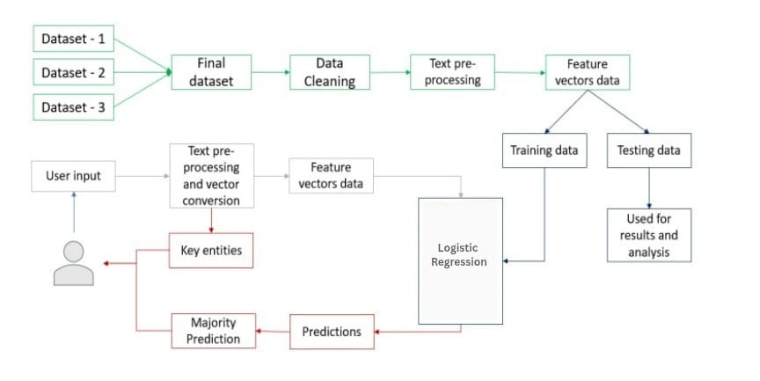
1. Combine datasets into one final dataset
2. Clean & preprocess the text data
3. Convert to feature vectors
4. Split into training and testing data
5. Train model using Logistic Regression
6. User inputs email → preprocessed → converted
7. Model predicts if it’s spam or ham
WORK FLOW :

Slide 7
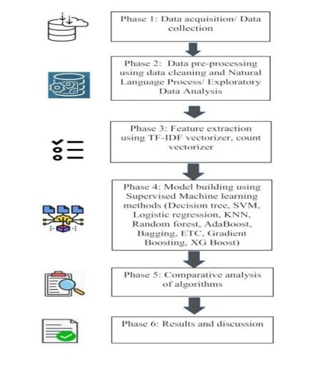
METHODOLOGY:
Phase 1: Data Collection from Kaggle (spam & ham emails)
Phase 2: Data Cleaning (lowercase, punctuation, stop words removal)
Phase 3: Feature Extraction using TF-IDF Vectorizer
Phase 4: Model Building with Logistic Regression
Phase 5: Comparative Analysis of algorithms
Phase 6: Results & Discussion (Accuracy: 96.9%)

Slide 8
Data Collection:
Collected from Kaggle’s spam email dataset
Includes 5,574 emails labeled as spam or ham
Data Processing:
Removed punctuation, special characters, and numbers
Converted text to lowercase
Removed stop words (common, non-informative words)
Performed tokenization

Slide 9



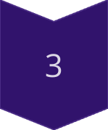
The Power of TF-IDF
Term Frequency
Frequency of a term in the document.
Inverse Document Frequency
Measure of how rare or common a term is.
TF-IDF
Product of TF and IDF, indicating term importance.

Slide 10



Machine Learning with Logistic Regression
Prediction
1
Spam or Ham?
2
Model Training
3
Feature Extraction
Process involves data pre-processing, feature extraction, model training, evaluation, and deployment. TF-IDF allows the classification model to analyze patterns and distinguish spam messages from legitimate emails effectively.

Slide 11



Experimentation and Methods Overview
Clear Methodology
Effective Techniques
Accurate Classification
Using machine learning with TF-IDF for feature extraction and Logistic Regression for classification. This approach enhances performance and ensures effective spam detection.

Slide 12



Tackling Spam with Machine Learning
Text Classification
Machine Learning
Essential for filtering incoming emails. Determines if an email should go to the inbox or spam folder.
Enables automatic classification of text. Uses pre-labelled text to identify patterns.
Feature Extraction
Converts text into numerical representations (vectors). Reflects word frequencies in a dictionary.

Slide 13

Results: Model Performance
99.30%
Training Accuracy
96.77%
Testing Accuracy
The Logistic Regression model demonstrated high accuracy on both training and testing datasets. It indicates the model generalizes well to unseen data.

Slide 14

Conclusion and Future Enhancements
Future: Deep Learning
Real-Time Filtering
Adaptive Learning
The email spam detection system is effective, providing a foundation for future advancements. Incorporating deep learning, real-time filtering, and adaptive learning will enhance the system.

